Slide 1
José Marco-Paredes
Senior Policy & Communications Analyst

Slide 2
Census 2020 overview
With the estimated state population declining, Illinois will loose one congressional seat, but could loose a second representative.
In Illinois $953 are lost annually for each person not counted.
In 2016, the number of Latinos living in Illinois was 2,178,790. Latinos are 17% of the state’s total population.
The 2010 Census missed 1.5% of Latinos
The Law requires the Census Bureau to keep everyone’s information confidential.

Slide 3
The importance of counting all children in the census 2020
The census consistently undercounts children younger than age of 5 at much higher rate than any other age group.
The 2010 census failed to count almost one million children 0-4. Of those, 400,000 were Latinos.
The undercount of young Latino children in the 2010 Census in Cook County: 11,000.
The net undercount rate for young Latinos was 7.1 percent, compared to 4.3 percent for non-Latinos.
Source: NALEO

Slide 4
Why does an undercount happen?
Latinos are more likely than non-Latinos to live in hard-to-count places (e.g. areas with multi-unit buildings and a high proportion of renters.
Latinos are more likely than non-Latinos to live in hard-to-count families and households, such as multigenerational and highly mobile families, and households with complex relationships.
Latino adults are more likely than non-Latino adults to believe that young children do not need to be reported on the census form.
Source: NALEO

Slide 5
The implications of an undercount of Latino children
The undercount of Latino children reduced potential federal funding for state programs serving low-income families.
Four federal assistance programs –Head Start; the Special Supplemental Program for Women, Infants, and Children (WIC); the Children Care and Development Block Grant; and the Maternal and Child Health Services Block Grant- distribute $20 billion annually to states and localities based, at least in part on census data.
Yet 21 percent of Latino children 0-5, that is 47,000, live in poverty.
Source: https://datacenter.kidscount.org/data/tables/8447-children-in-poverty-100-by-age-group-and-race-and-ethnicity?loc=15&loct=2#detailed/2/15/false/37,871,870,573,869,36,133,35,16/2757,4087,3654,3301,2322,3307,2664|17/17079,17080

Slide 6
An undercount means less resources for educators
Census data determine funds for services that support special education students.
Census data determine funding which also helps second language learners.
Census data determines funds for Supplemental Nutritional Assistance Programs and Child Nutrition Programs like the National School Lunch Program and School Breakfast Program.
Census data also affect the Child and Adult Care Food Program used by childcare providers and food stamps program (known as SNAP).
Source: NALEO
Notes:
Special Education: These services include specially trained staff like psychologists, one-to-one teacher assistants, and resources for teachers.
Bilingual Ed: The school can buy bilingual instructional materials that children can access to learn new content while they are learning the English language.

Slide 7
Direct and indirect impact on schools
It impacts the amount of revenue that districts receive.
It avoids classroom overcrowding.
It impacts the number of teachers that can be hired.
It impacts teacher’s access to instructional materials and training.
It impacts teacher’s access to a safe school site.
It impacts the district’s ability to hire highly qualified and its ability to offer competitive salaries to prospective new hires.
Source: NALEO

Slide 8
Manny Gonzales
Communications Manager

Slide 9
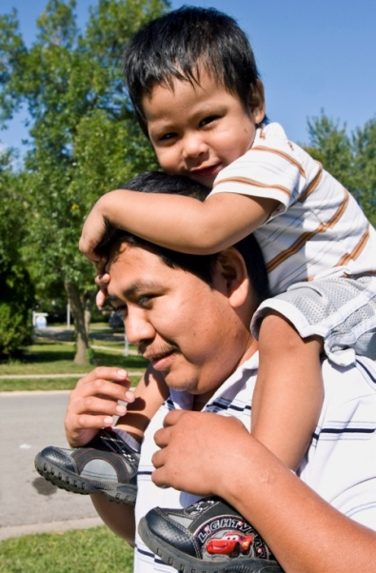
Strength in Numbers The Forum’s Census 2020 Project #ILCountMeIn2020
The Urban Institute projects as many as 2.2 million (3.57%) Latinos could be undercounted in the 2020 census.
In their high-risk scenario, that means as many 79,300 in Illinois could be miscounted!
For its Census 2020 Project, The Latino Policy Forum will:
Provide communication materials and best practices guidance to up to 100 participating organizations, CBO’s, school districts, and Latin American consulates.
Create census-related programming with media partners, including Univision and regional radio stations, with the prospect of reaching more than 1 million Latinos, especially Spanish speakers.

Slide 10
Strength in Numbers The Forum’s Census 2020 Project #ILCountMeIn2020
The Forum will:
Provide template materials for print, social media, and presentations, related to the range of census participation barriers itemized above;
identify and share best practices;
Coordinate dissemination of materials for maximum impact.
Decision-making about the outreach approach will reside with the participating organization.
.
Goal: Mobilized grassroots voices from online platforms to offline action, engagement and Census participation

Slide 11
Strength in Numbers The Forum’s Census 2020 Project #ILCountMeIn2020
Messages to be curated around the following:
Birth to 5
Citizenship
Safety
Avoid the Door Knock
Economic Impact
Latinos in General
Libraries and electronic assistance locations
Hard to Count in General
Confidentiality of Census – Safety
Each message to include fact sheet, memes, video, and distributed via Instagram, Twitter, Facebook, and YouTube.
Goal: Mobilized grassroots voices from online platforms to offline action, engagement and Census participation

Slide 12
Strength in Numbers The Forum’s Census 2020 Project #ILCountMeIn2020

Slide 13
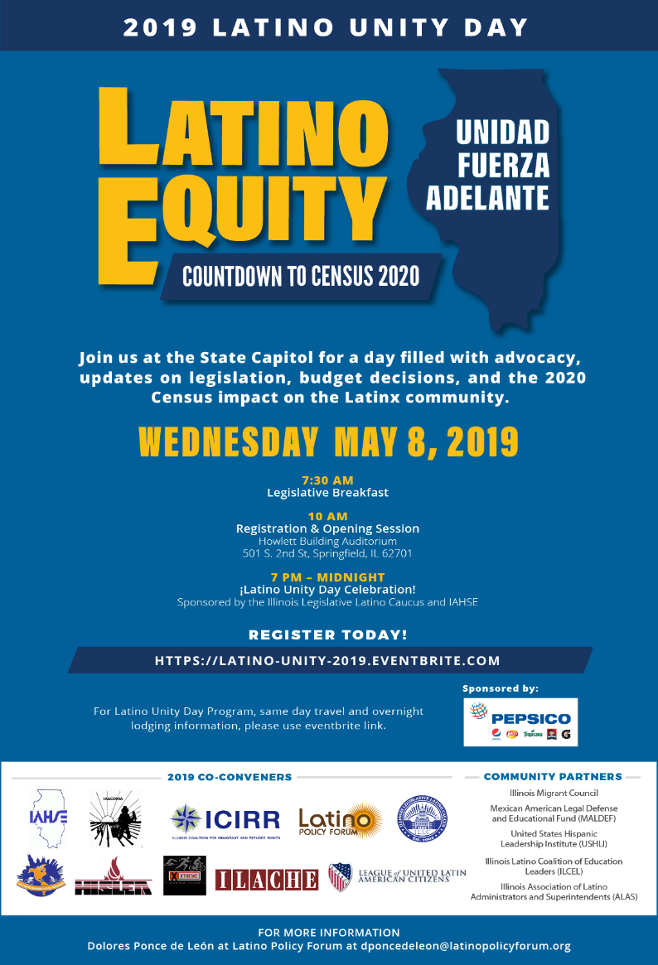
Strength in Numbers The Forum’s Census 2020 Project #ILCountMeIn2020
Here We Go!
The Forum has already co-convened Latino Unity Day on May 8 in Springfield, an annual day of advocacy, but this year’s theme was around the importance of supporting Census 2020 outreach!
The Forum has also been engaged with media partners Telemundo, iHeart Media and WTTW to promote the Census.

Slide 14
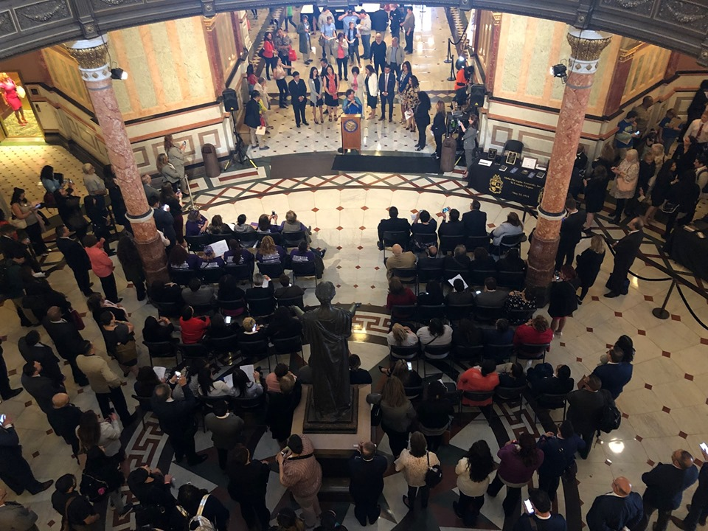
Strength in Numbers The Forum’s Census 2020 Project #ILCountMeIn2020
JOIN US!
Facebook: Latino Policy Forum
Twitter: @latinopolicy

