Slide 1
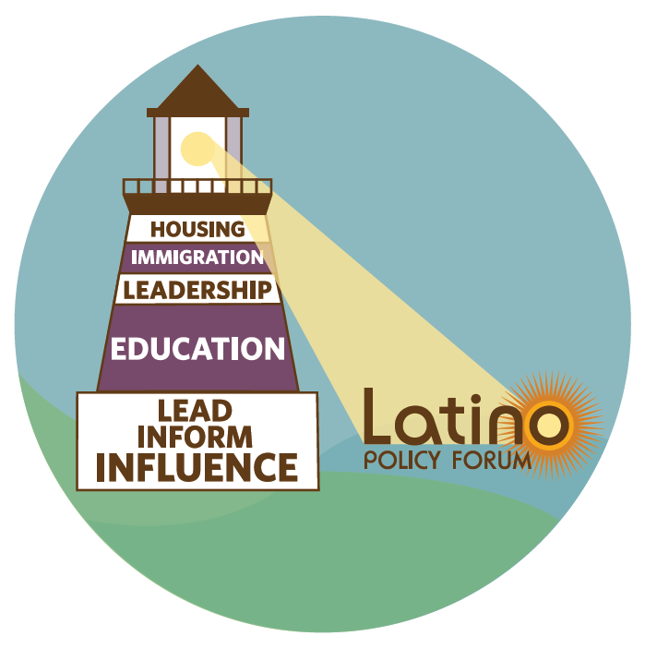
New Strategic Plan
December 2016

Slide 2
Executive summary
Seven years since its inception, the Latino Policy Forum is at a reflection point
The funding for our organization has increased 2.5x
We have expanded our focus areas beyond the original housing to education, immigration, & leadership
Through our advocacy, research synthesis, and equipping of the community, we have come to be seen as the leading voice for Latinos in the Illinois area
The Forum engaged BCG to support a strategic planning process evaluating how to achieve maximum impact for the Latino community based on the needs and strengths of the Forum
We engaged numerous stakeholders including policy makers, community partners and funders, benchmarked 270+ Latino organizations nationwide, and held workshops with the Board and staff to better understand the Forum's strengths and best path forward
We gathered a number of significant insights from this process, including:
We have an opportunity to better prioritize the work we do to avoid stretching staff to thin
Recent shifts in focus have led to the majority of time being spent on equipping the community (training), with an opportunity for us to refocus attention back to our core of advocacy and supporting research synthesis
As a result of this strategic planning exercise, we will become a more focused, impactful Forum that:
Drives the economic mobility of Latinos through frequent and targeted advocacy for change in education, housing, and immigration policies
Complements our advocacy efforts through state-wide research synthesis and strategic equipping community efforts, including the Leadership Academy

Slide 3
Table of Contents
Latinos in Illinois
The state of the Forum and Latino non-profits
Needs of the community
The Forum's value
Strategic plan
Appendix

Slide 4
As the largest ethnic group in Illinois, Latinos interests need to be effectively represented in Springfield
Illinois Latino Population:
2.2M people, a 44% increase since 2000
Latinos represent a large and growing segment of the state's population
Note: Latino of any race; White, not Hispanic or Latino; Black, not Hispanic or Latino
Source: U.S. Bureau of the Census. 2014 Population Estimates
Notes:
Latinos are the largest ethnic minority group in Illinois, comprising 17 percent of the population. This has been the case since the beginning of the decade, during which time the Latino population has experienced rapid growth.

Slide 5
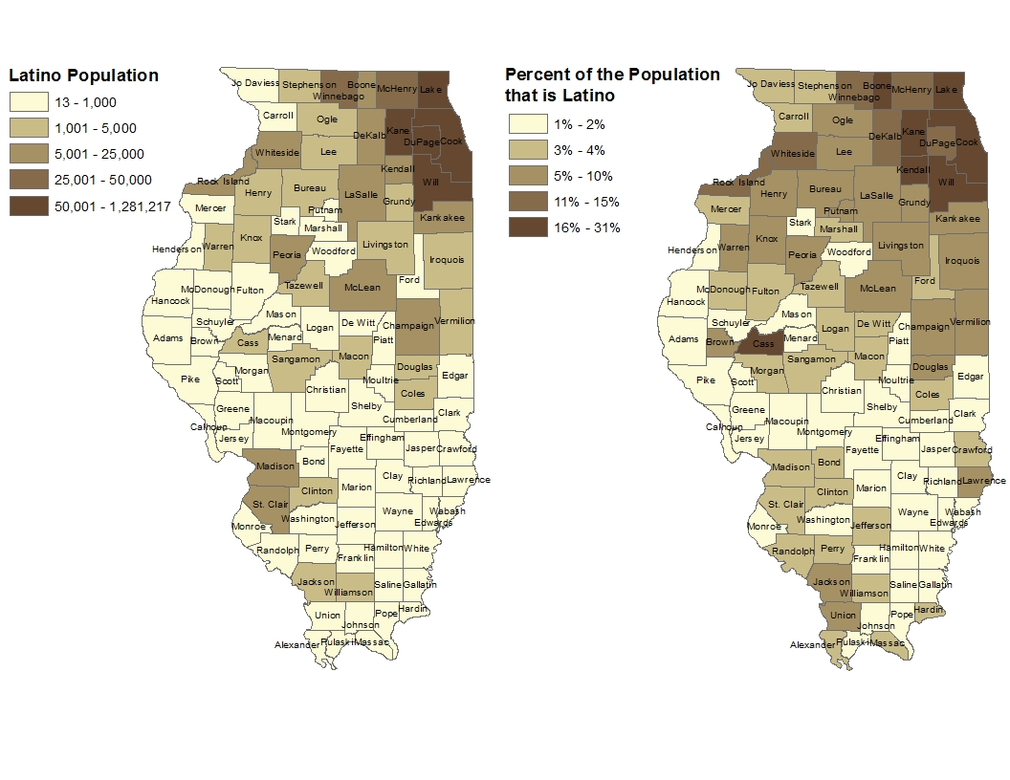
Dispersed Latino population requires state-level organization, in addition to work in Chicago
While largest numbers of Latinos live in the Chicagoland area ...
... Latinos represent large proportions of the population throughout Illinois
Source: U.S. Census Bureau, 2010-2014
American Community Survey
Notes:
Latinos are not just in the Chicago region. We are every where in the State

Slide 6
Many issues are top of mind for the Latino community...
Education
ECE
K-12
Post-secondary
Parent engagement
Housing
Affordable housing
Housing education
Foreclosures
Homelessness
Immigration
Reform / Policy
Integration
Translation services
Leadership
Political leadership
Business leadership
Community leadership & capacity growth
Health
Coverage/care
Nutrition
Substance abuse
HIV/AIDs
Disabilities
Voting & Civic Participation
Voter registration
Civic advocacy
Media relations
Economic support
Retirement
Loans / debt
Financial services
Employment
Job search
Workforce develop.
Worker rights
Civil Rights & Criminal Justice
Justice reform
Juvenile support
Legal assistance
Culture
Arts
Cultural celebrations
Family / Children
Pregnancy
Child care
Youth support
Domestic abuse

Slide 7
... and five models of engagement exist for organizations like the Forum to work to improve the status quo
Inform
Influence
Lead
Research
Synthesize and share
Advocate
Equip community
Provide services
Conduct new primary research to determine recommendations for improving community
Review, analyze,
synthesize, and disseminate research findings to inform community of recommended changes
Act on behalf of, and alongside, community to encourage government to act on recommended changes, achieve impact at scale
Train community in civic engagement to enable them to become own advocates for recommended changes
Directly provide improvements to community
Think
tank
Moving further right brings organizations closer to the ground
Direct programmer
Many organizations engage the community in multiple ways to drive maximum impact

Slide 8
The Forum's strategic plan seeks to define the optimal intersection of focus areas and models of engagement
Forum models of engagement today
Where are the needs of the community?
Where can the Forum best provide value to the community?
Strategic plan: Where should the Forum focus on becoming a leader?
Synthesize and share
Advocate
Equip community
Education
Housing
Forum areas of focus today
Immigration
Leadership
Voting & Civic Participation
Society Change
Policy Change
Community Change

Slide 9
Needs: 270 nation-wide organizations exist today focused on Latino issues
71
(including Acuerdo members)
3
12
7
3
6
7
8
4
2
10
1
60
7
15
3
2
3
7
1
4
3
5
11
3
9
1
1
1
1
2
17
National organizations
25
1
1
10
Number of Latino organizations benchmarked by state
Additionally, >25 advocacy organizations focused on issues outside the Latino community reviewed
Source: NCLR partner list, Latino Policy Forum peer list, BCG research

Slide 10
Needs: While many Latino focused organizations, few focus on research or advocacy, especially in Illinois
Limited policy research conducted or shared, especially with Illinois focus
Few benchmarks have an
advocacy / policy agenda
Existing institutes publish infrequently:
Type of engagement by benchmarked Latino
organizations nationwide
Institute |  | 2015 Publications
Pew Research Center |  | 10 reports / profiles
UC Berkeley |  | 4-part publication
NiLP |  | 3 publications
William C. Velasquez Institute |  | 3 publications
Roger Williams |  | 2 infographics
Tomás Rivera Institute |  | 1 publication
17 of which are based in DC
Programming only
Advocacy / Policy work
Latino Policy Forum helps to fill this gap in Illinois through its work in advocacy and research synthesis
Source: Organization websites, annual reports

Slide 11
28 Organizations Nationwide With Comprehensive Focus on Latino Issues – 17 in Washington D.C.
17
Source: NCLR partner list, Latino Policy Forum peer list, BCG research

Slide 12
Needs: Survey of Latino leaders shows growing concern for jobs, income and continued focus on education, immigration
Spike in concern for economic issues last two years...
...while immigration & education important, but falling...
... and health and housing remain lowest priorities
% of Latino leaders who chose issue as "Most important for Latinos"
2013
2015
Latino Policy Forum expertise exists
Historical focus
of Forum
2
0
1
Jobs / the Economy
Income inequality / Poverty
Immigration
Education
Health
Housing
Education and housing work is also an important driver of improving income inequality and job prospects of Latinos
Source: NiLP National Latino Opinion Leaders Survey 2015 (N=345), 2013 (N=359)

Slide 13
Needs: These trends hold true in Illinois, where growing Latino population is struggling to find good jobs and education
Despite growing population, resources slow to reallocate
Latinos still lowest earners in Illinois
Latinos have highest school dropout rates for IL
Median personal earnings, '000 (2013)
High school dropout rates (2010)
Latinos remain under the radar for many policy discussions in IL
Seen as a "sleeping giant" which many in IL are not aware make up such a large percentage of population
Less vocal in advocacy than other minority groups
Problems may be exacerbated as Latino communities spread across state to areas less equipped for Latino programs
Many school districts are rapidly become majority Latino outside of Cook County
More dispersed population adds challenges to direct programming and translation services
Illustrates need for state-level advocacy
National
Illinois
Illinois
Caucasian
Black
Latinos
Caucasian
Black
Latinos
Latino males at nearly 30% dropout levels, highest of any demographic
Source: Pew Research Center on Hispanic Trends: Statistical Portrait of Hispanics in the United States and Illinois, 2011

Slide 14
Needs: Advocacy has outsized impact due to low Latinos representation in political institutions nationwide and in IL
National representation
Illinois representation
At 5,850, number of Latino elected officials growing, but still under represented
Illinois Statewide Office
1992
Latino
2012
Illinois US House Delegation
1992
Latinos hold only 3.3% of elected seats nationally, in spite of the fact that they make up 16% of the overall population.
2012
Illinois Senate
1992
2012
Illinois House
1992
2012
Cook County-wide officials
1992
3.3%
2012
16%
Cook County Board
1992
2012
Chicago City Office
1992
2012
Low Latino voter turnout (less than 50% in 2012 presidential election) exacerbates problem
Source: National Association of Latino Elected and Appointed Officials NALEO

Slide 15
Needs: Acuerdo members view Forum as important in helping achieve their mission and engage in policy change
Majority of Acuerdo members conduct more advocacy due to their involvement with Forum
>70% of respondents believe the Forum helps them achieve their mission & engage in policy
As a result of your engagement with the Forum, to what extent has
your organization engaged in the following advocacy and
policy activities¹? (n =34 )
Not at all /Don’t Know
Slightly
To some extent
To a great extent
Has collaboration with the Acuerdo strengthened your organization's ability to achieve its mission? (n=38)
Communicating with elected officials
82%
13 %
Communicating / partnering with government administrator
77%
~75% say Forum has strengthened their ability to achieve their mission
Training and educating constiuents and clients
71%
Testifying in public hearings
66%
To what extent did your advocacy with the Forum strengthen your organization's capacity to make and engage in policy change? (n=39)
Sitting on relevant boards committees, and/or commissio
56%
Other²
3%
% of respondents
~60% say Forum has strengthened their ability make policy change
Percentage of respondents that answered "To a great extent" or "to some extent" for survey question
Other – response: "Conducting outreach in various community events and festivals"
Source: Acuerdo survey

Slide 16
Needs: Acuerdos believe that actions that bridge those on the ground with decision makers are the most impactful
Access to decision makers are the most impactful Acuerdo activities...
... due to the connection of policy makers with those on the ground²
% who consider activity highly effective¹
"Without the change in government and without the change in our politics we are not able to make a change at the lower level"
"As a small organization, on our own it's hard to access decision makers, get administrative change that would benefit our work and advance Latino interests"
"Latino service organizations are usually busy on the ground and are often times not invited to the decision table [but Latino Policy Forum is our seat at the table]"
From your perspective, select the three most
impactful activities for the Acuerdo to undertake (n=39)
Meeting with elected officials and gov’t admins
83%
Training and educating constituents and clients
70%
Organizing events with policy makers
80%
Attending issue education sessions with policymakers
57%
Submitting public comments on specific bill/issues
78%
Testifying in public hearings
67%
% of respondents
Answered "To a great extent" to " For these activities, please rate the effectiveness of the Acuerdo in undertaking these activities."
Survey question: "Please explain why these activities are the most impactful"
Source: Acuerdo survey

Slide 17
Forum value: Six drivers to be successful agent of change, especially in policy and advocacy arena
Success drivers |  |  | Key enablers of strategy |  | Risks/threats
Relationships Use network to enact change Respected leadership, board |  |  | High-powered board Use connections to affect change Strong history and reputation |  | Reputation and biases of partners will impact own brand
Credible voice Fact-based, data-driven policies |  |  | Research-oriented positions Commitment to minimizing bias |  | Research requires high resource level
Brave policy agenda Difficult policy problems can attract wide support |  |  | Willingness to risk social capital with funders and stakeholders Independence from government |  | Government independence limits funding opportunities May risk funding
Measured impact reporting Integral part of implementation solution and communicate role Voice of change for community |  |  | Understand how to execute Rigorous monitoring of impact indicators and frequent reporting |  | Focus on measuring impact may discourage advocacy efforts that are hard to measure
Clearly defined brand Promote brand while trumpeting need for change Direct & indirect funding impact |  |  | Single, defining message Frequent, clear communications Willingness and ability to articulate organization's brand |  | Overly narrow scope can make it harder to adapt to changing community needs
Strong, diversified funding base Combination of funds from larger foundations, corporations, and individuals |  |  | Strong development office in organization Leveraging board for funding relationships |  | Broader funder base can create competing priorities
1
2
3
4
5
6

Slide 18
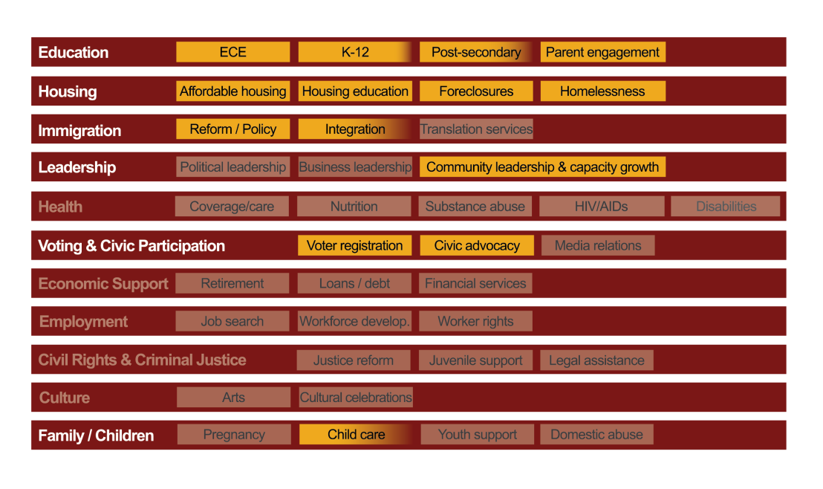
Forum value: Strategic planning identified strong need to prioritize and keep advocacy at the core of work
Areas of focus: Forum must prioritize areas of strength & achieve depth in them
Models of engagement: All activities must contribute to driving policy change
Equipping community through training done in-so- much as it supports increased advocacy
Better to grow depth in existing areas of strength (e.g., education)...
... than breadth across areas
Advocate
Synthesize and share
Equip community
Research, analysis,
synthesis done for the purpose of supporting policy change

Slide 19
Forum value: The Forum will focus efforts in areas of greatest need and impact for the Illinois Latino community
Forum advances the interest of Latinos through advocacy
Rebalancing work across areas of focus...
... and models of engagement to fill important gaps
Increased focus on education advocacy promotes long-term prosperity for Latinos in Illinois
Continued advocacy in housing promotes wealth acquisition in the community and supports work in education
Immigration and leadership work retains most valuable equipping community activities, but increases advocacy efforts at state and local levels
Housing
Re-search syn-thesis
Advo-cacy
Equip Community
Today
Education
Today
Immigration
Leadership
Voting & civic part.
Education > 50%
Re-search syn-thesis
Advocacy & Policy
>50%
Equip Community
Future
New
Housing
Immigration
Leadership

Slide 20
About Us
Through advocacy and analysis, the Forum builds a foundation for equity, justice and economic prosperity for the Latino community. By catalyzing policy change, the Forum works to improve education outcomes, advocate for affordable housing, promote just immigration policies and strengthen community leadership.

Slide 21
“The Forum’s commitment to Latinos in Illinois is resolute. Together we will bridge the divide and advance the interest of Latinos families and Illinois.
The Forum will continue to speak truth, advocate for justice, act with civility and integrity, and put trust in democracy”–S. Puente

